Slide 1

211521104125
REVATHI.R
FINAL PROJECT

Slide 2

FASHION RECOMMENDATION SYSTEM
USING AI

Slide 3






AGENDA:
Introduction to Fashion Recommendation Project
Data Collection and Preprocessing
Graph Construction
PageRank Algorithm
Implementation
Evaluation Metrics
User Interface Design
Future Directions and Improvements
Conclusion

Slide 4




PROBLEM STATEMENT
The problem statement for the fashion recommendation project utilizing the Nearest Neighbor PageRank algorithm could be formulated as follows:
OBJECTIVES:
"In today's fashion landscape, consumers are inundated with an overwhelming array of clothing options, making it challenging to discover items that align with their personal preferences and style. Additionally, online shopping platforms struggle to provide tailored recommendations that accurately reflect individual tastes, often leading to frustration and dissatisfaction among users.
CURRENT SITUATION:
To address this issue, our project aims to develop a robust fashion recommendation system powered by advanced machine learning techniques, specifically leveraging the Nearest Neighbor PageRank algorithm. This system will analyze a diverse dataset of fashion items, including images and metadata, to construct a comprehensive fashion graph that captures the inherent similarities between different pieces of clothing.
PROPOSED SOLUTION:
By applying the Nearest Neighbor PageRank algorithm to this fashion graph, we seek to identify the most relevant and personalized recommendations for users based on their preferences and browsing history. This approach will not only enhance the online shopping experience by providing curated suggestions but also empower users to explore new styles and trends that resonate with their unique fashion sensibilities.
OUTCOMES:
Through the implementation and evaluation of this recommendation system, we aim to improve customer satisfaction, increase engagement on e-commerce platforms, and ultimately revolutionize the way individuals discover and interact with fashion online."

Slide 5
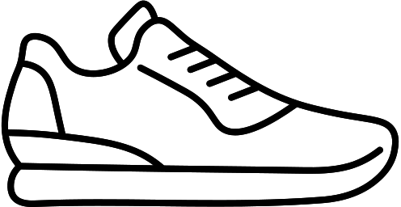
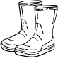
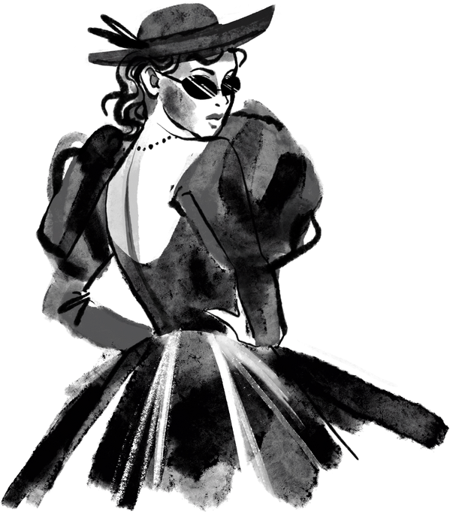
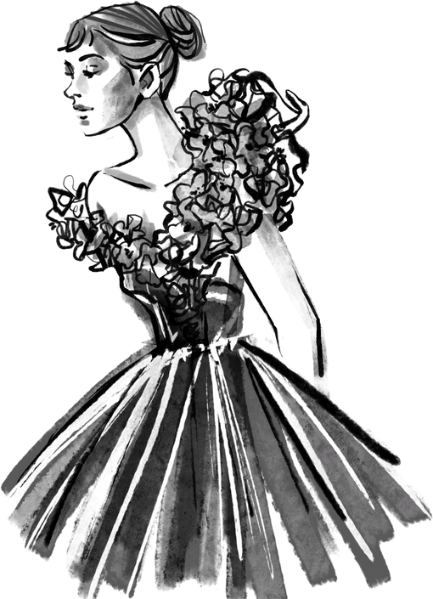

PROJECT OVERVIEW:
AI PROJECTS:
MOTIVATION:
Our project aims to develop a cutting-edge fashion recommendation system using the Nearest Neighbor PageRank algorithm. In today's fashion landscape, consumers face challenges in discovering clothing items that suit their personal style preferences. Traditional recommendation systems often fail to provide personalized suggestions, leading to frustration and dissatisfaction among users.
The Nearest Neighbor PageRank algorithm will play a central role in our recommendation system. By computing PageRank scores on the fashion graph, we can identify the most relevant and similar items to a user's preferences or query. This approach enables us to offer tailored recommendations that align closely with individual tastes and preferences.

Slide 6



SOLUTION:
Personalized Recommendations: By analyzing a diverse dataset of fashion items and constructing a comprehensive fashion graph, our system can generate personalized recommendations based on the user's preferences and browsing history.
Advanced Algorithm: The Nearest Neighbor PageRank algorithm serves as the backbone of our recommendation system, enabling us to identify the most relevant and similar items to a user's query.
VALUABLE PROPOSITION:
Business Growth Opportunities: For fashion retailers and e-commerce platforms, our recommendation system presents valuable opportunities for driving sales and increasing customer loyalty.
Innovation and Differentiation: In an increasingly competitive market, our solution offers a unique value proposition by leveraging cutting-edge machine learning techniques to deliver highly personalized recommendations.
SOLUTION AND ITS VALUABLE PROPOSITION:

Slide 7
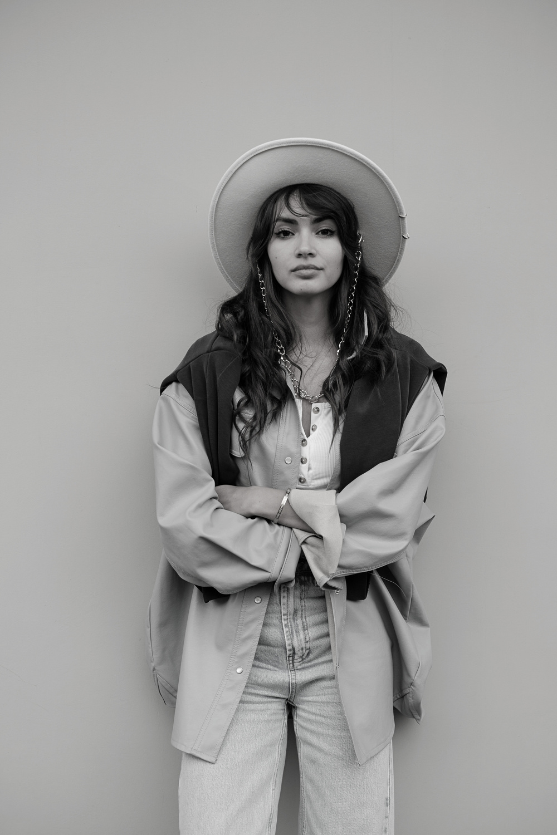
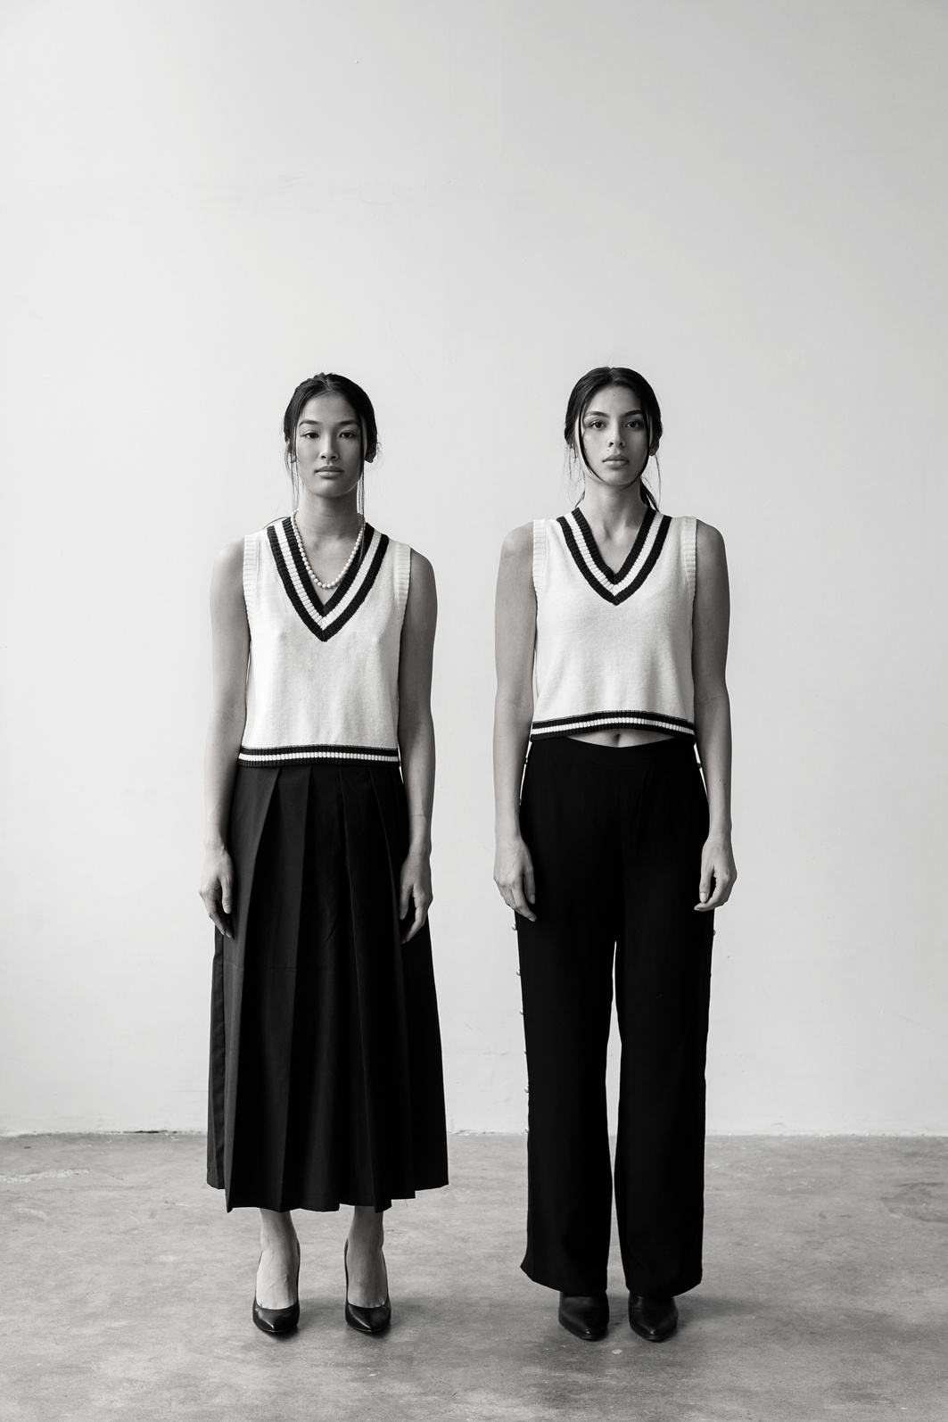


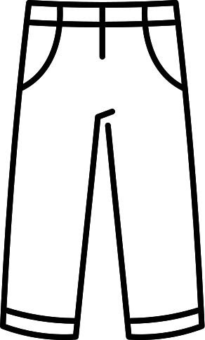

WHO ARE THE END USERS?
5.Stylists and Fashion
Professionals
6.Fashion Bloggers and Influencers:
1.Individual
Consumers
2.Online Shoppers
3.Fashion Enthusiasts
4.Fashion Retailers
The end users can vary depending on the specific application and context of the fashion recommendation system.

Slide 8
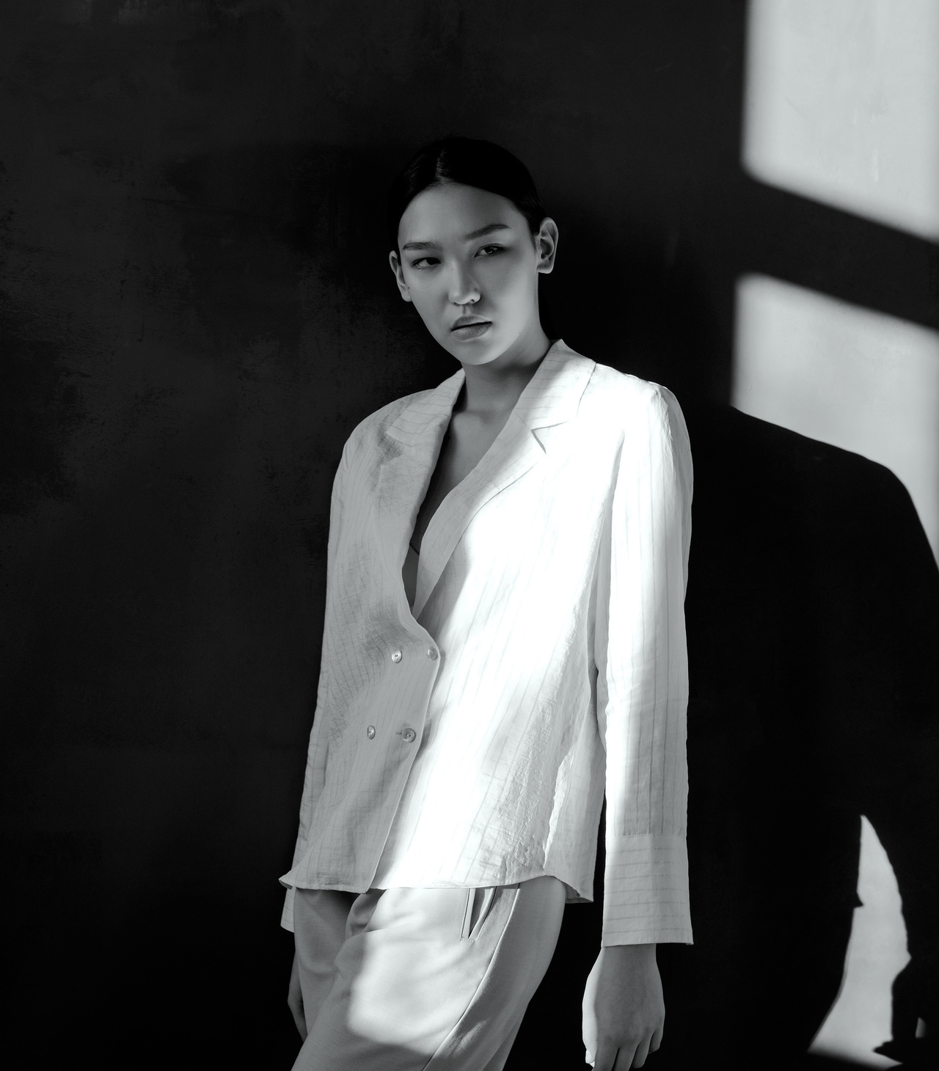
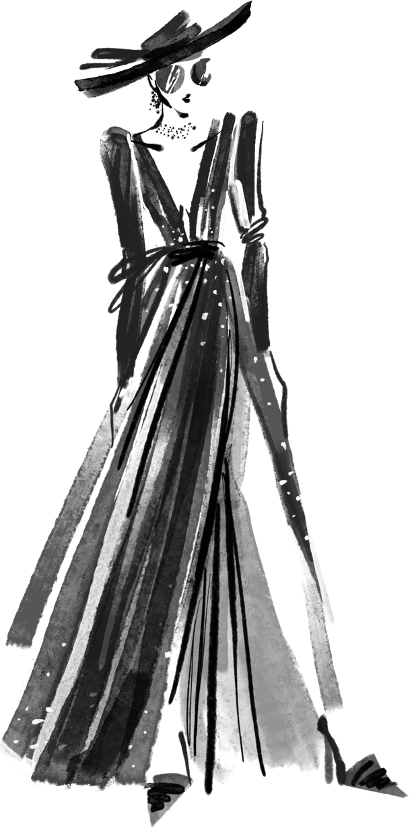
THE WOW IN MY SOLUTION:
Nearest Neighbor PageRank Algorithm: While traditional recommendation systems often rely on collaborative filtering or content-based methods, our solution sets itself apart by leveraging the Nearest Neighbor PageRank algorithm.
Comprehensive Fashion Graph: Our solution constructs a fashion graph that captures the complex relationships between different clothing items based on various features such as color, style, and pattern.
Personalized User Experience: Unlike one-size-fits-all recommendation systems, our solution prioritizes personalization, offering tailored recommendations that align closely with individual tastes and preferences.
Enhanced Accuracy and Relevance: By incorporating the Nearest Neighbor PageRank algorithm, our solution enhances the accuracy and relevance of the recommendations provided to users.
Seamless Integration and Scalability: Our solution is designed for seamless integration with existing e-commerce platforms and fashion websites, allowing retailers to easily incorporate personalized recommendation features into their online shopping experience.

Slide 9



MODELLING:
Graph Construction: Building a fashion graph where each node represents a fashion item (e.g., clothing item) and edges represent similarities between items. The graph can be constructed based on features extracted in the previous step, such as color, style, pattern, etc. Various similarity measures, such as cosine similarity or Euclidean distance, can be used to determine edge weights.
PageRank Algorithm: Implementing the PageRank algorithm to compute scores for each node (fashion item) in the fashion graph. The PageRank algorithm takes into account both the local structure of the graph (i.e., incoming and outgoing edges) and the global importance of nodes within the graph. This helps identify the most influential and relevant items in the fashion graph.
Nearest Neighbor Search: Utilizing the computed PageRank scores to perform nearest neighbor search for a given query item or user preferences. This involves identifying items with high PageRank scores that are similar to the query item or preferences. Techniques such as k-nearest neighbors (k-NN) can be used to efficiently find nearest neighbors in the fashion graph.
.

Slide 10





RESULT:
The simple result of the fashion recommendation system using the Nearest Neighbor PageRank algorithm would be personalized recommendations that accurately match users' preferences, leading to improved satisfaction and engagement with the platform.

